Slide 1
Lamda-phage DNA tracking data analysis using bootstrap method

Slide 2
Motivation
a large distribution of diffusion coefficients in our second lambda phage DNA measurement (3.8kbp ones)
Wide diffusion coefficients distribution is due to that there are several species of DNA molecules with different polymer length.
Can we can identify subpopulation with their diffusion coefficients?

Slide 3
Traditional way to determine diffusion coefficient and their confidence intervals is:
Compute MSD(tau)
Fit to the model and obtain x,y,z diffusion coe
Use xyz average and std as mean and measurement error.
This method gives large measurement error
Fits subjects to many other parameters such as fluorescence background, gain settings and model used.
It converges slower (statistically bootstrap is an order better than central limit theorem.).
Our x,y,z do behave differently.

Slide 4
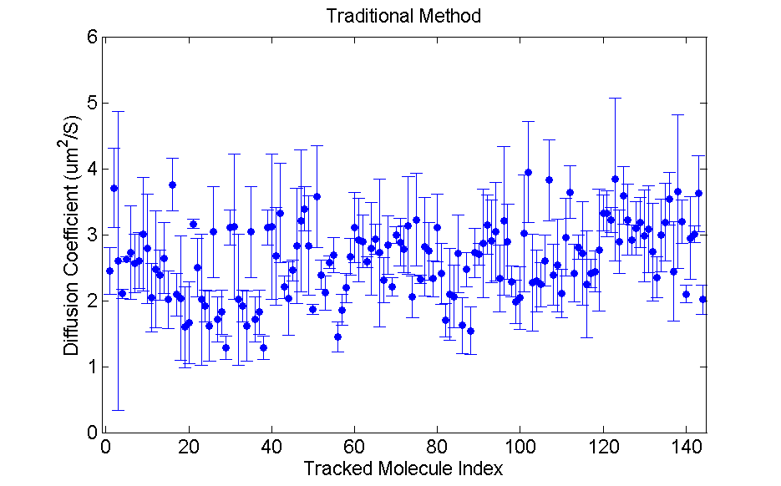
Our diffusion coe errors are too large to allow identifying any subpopulations.

Slide 5
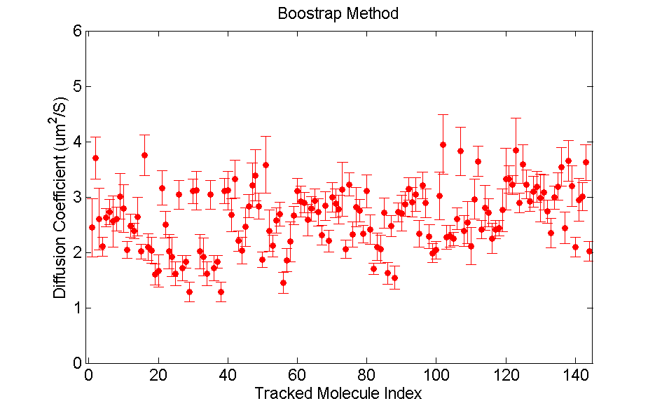
Std from traditional method: 0.50 um^2/S.
Std from bootstrap method: 0.27 um^2/S.
Std determines bin size in histograms…

Slide 6
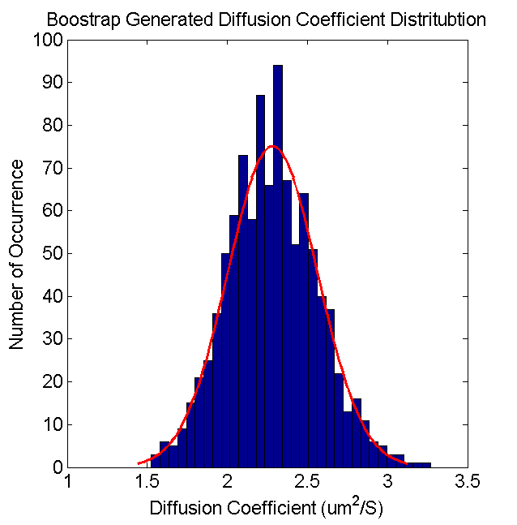
How does bootstrap do this?
Take a trajectory. Get DeltaX = X(deltaT*(k+1))-X(deltaT*k).
We know from diffusion model DeltaX’s are iid, so we can generate bootstrap states using DeltaX, with some rules…
Calculate diffusion coe from each generated DeltaX set.
Use diffusion coe distribution to obtain new c.i.
For example, figure on the left is a generated diffusion coe distribution.
A good reference book: An introduction to the Bootstrap by Efron.

Slide 7
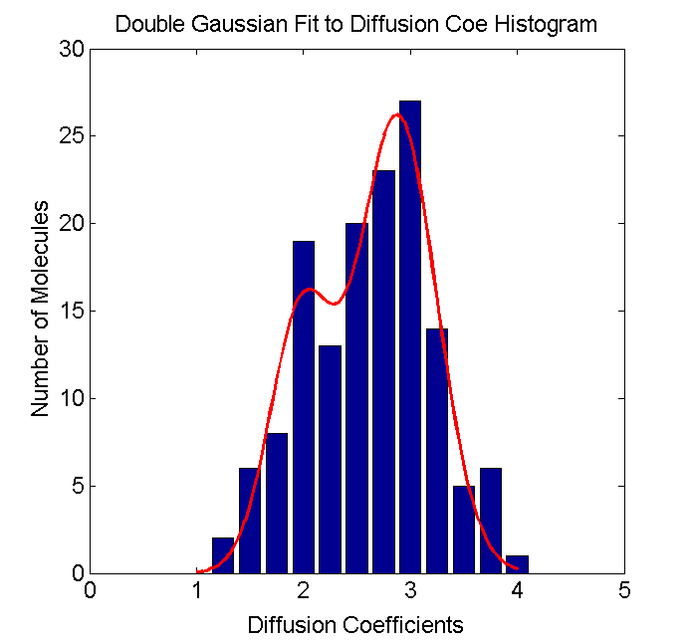
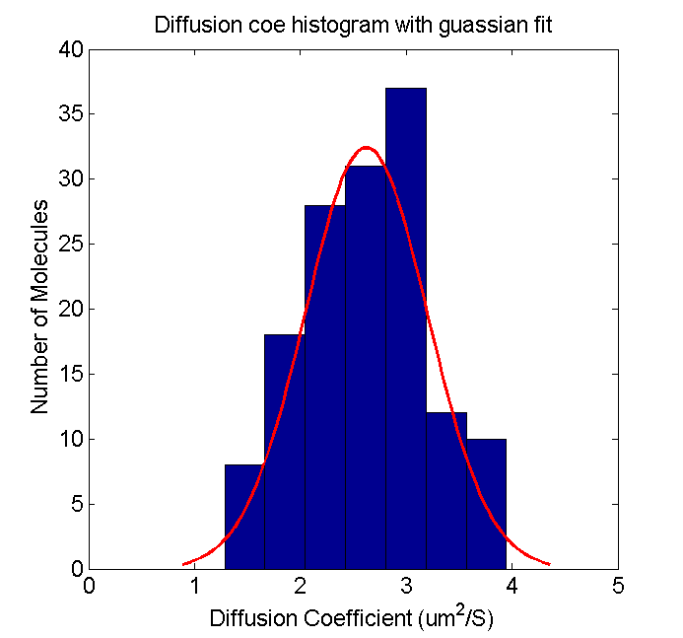
Now let’s look at 3.8kbp DNA diffusion coe histogram.
Can only plot histogram with 0.5um^2/S bin size by traditional way. Single guassian fit tells that a single species with diffusion coe of 2.6 um^2/S.
With bootstrap, 0.25 um^2/S bin size. Refined histogram.
At least two population, with diffusion coefficients 1.98 and 2.88 um^2/S. Roughly 36% is 1.98 um^2/S with the rest 2.88 um^2/S. If there is more species we need to take more data.

Slide 8
Conclusion
Bootstrap method is very useful in our diffusion data analysis by:
Converging faster and thus providing tight error bounds on diffusion coe
Fast and robust analysis than our traditional fitting methods. Fits now and then won’t work due to non-converging issues.
You can even do more analysis with bootstrap analysis as it is transformation invariant.

